Slide 1


Are You OK, 2020:
Media coverage on family violence should be conducted in such a way that the public knows that victims of family violence ‘cross all socioeconomic, ethnic, racial, sexual orientation, educational, age and religious lines’.
Extreme Family Violence in the New Zealand Media
Notes:
Mass media is a significant tool in shaping public understanding of key social issues such as family violence and is an effective way for getting messaging concerning the subject out to a wide audience. Media can be a critical ally for those committed to addressing family violence with its coverage both reflecting and shaping public opinion about the matter. By headlining a particular crime, The media can ensure it becomes a topical and major issue within the country. Many contend that journalists play a critical role in influencing public policy & government interventions regarding family violence.
However, a variety of studies have shown that the converse can also be true - that under-coverage of family violence in the media can create an environment that implicitly fosters violence by isolating the victims. Lack of media coverage can:
“allow family violence to remain hidden and can reinforce the control and domination of those who perpetrate such abuse by further isolating their targets as well as by supporting the notion that incidents of family violence are private and rare”
With the power to shape community perceptions and improve public visibility of the issues, but also the ability to implicitly condone or even fuel aggression, unbiased equitable media coverage is an essential component in the struggle to eradicate family violence in New Zealand. According to guidelines published by one of NZ’s leading family violence support agencies, Are You OK? (2020), media coverage on family violence should be conducted in such a way that the public knows that victims of family violence ‘cross all socioeconomic, ethnic, racial, sexual orientation, educational, age and religious lines’.
The purpose of our research was to address how well NZ digital media lives up to this standard. In particular, we investigated whether there is any systematic bias in the media coverage of extreme family violence (by which we mean family violence resulting in death) in terms of the gender, age and ethnicity of the victim as well as their relationship to the killer. More specifically, we investigate whether any of the aforementioned factors have a disproportionate effect on the number of articles written about the victim (exposure), whether these articles are afforded ‘front page’ status (prominence) and the overall sentiment of the articles (sentiment).

Slide 2


The Pressroom (DOT Loves Data)
946 online articles
Elderly Victims strongly under
represented in media
Pacific Island victims strongly under
represented in media
The Homicide Report (Stuff NZ)
329 Victims of Extreme Family Violence
Killer’s
Relationship
Gender
Age
Ethnicity
Notes:
The Homicide Report: The New Zealand Homicide Report is the first publicly searchable database of homicides in New Zealand and provides an exhaustive list of all victims of homicide in New Zealand since 2004. The objective of the Homicide Report is to provide the public with greater insight into the socio-economic issues surrounding homicides and the factors contributing to their occurrence. The database publishes details of the victim's full name, gender, date of death, age, cause of death and the relationship of the victim to the killer, as well as providing an image of the victim in most cases. In this study we are concerned with victims of extreme family violence only. As such, we refined the database to victims whereby the killer was defined either as a partner, relation of a partner, parent, child, sibling or extended family member of the victim. In this way, between 2005 and 2018 we identified 329 victims of extreme family violence
The Pressroom: Wellington based analytics company DOT Loves Data (DOT) has, to date, collated an archive of approximately 10 million news articles published within publicly available main-stream media platforms. This digital archive, referred to as ‘The Pressroom’, dates back to 2005 and contains comprehensive collections of articles published on New Zealand websites. The Pressroom is used to report on current events and to track trends in both media reporting and social opinion

Slide 3

ETHEL Sentiment Data (DOT Loves Data)
Negative Sentiment
0
Positive Sentiment
1
“For some perpetrators, being unable to access meth triggered an escalation in violence…”
“Brown said while it was good the Family Court responded quickly…”
Notes:
Sentiment Score Data:
‘Sentiment analysis’ is a natural language processing technique that quantifies the emotional polarity of text. This technique has spawned a burgeoning field of research in recent years with applications ranging from analysing the wide-spread mood of the population, to quantifying customer satisfaction, to predicting voter behaviour. Using a proprietary sentiment analyser, we were able to assign a sentiment score to all articles from the cohort written about victims of extreme family violence. By evaluating the sentiment scores of articles relating to victims from different groups, we were able to identify significant differences in the nature of the language used.

Slide 4
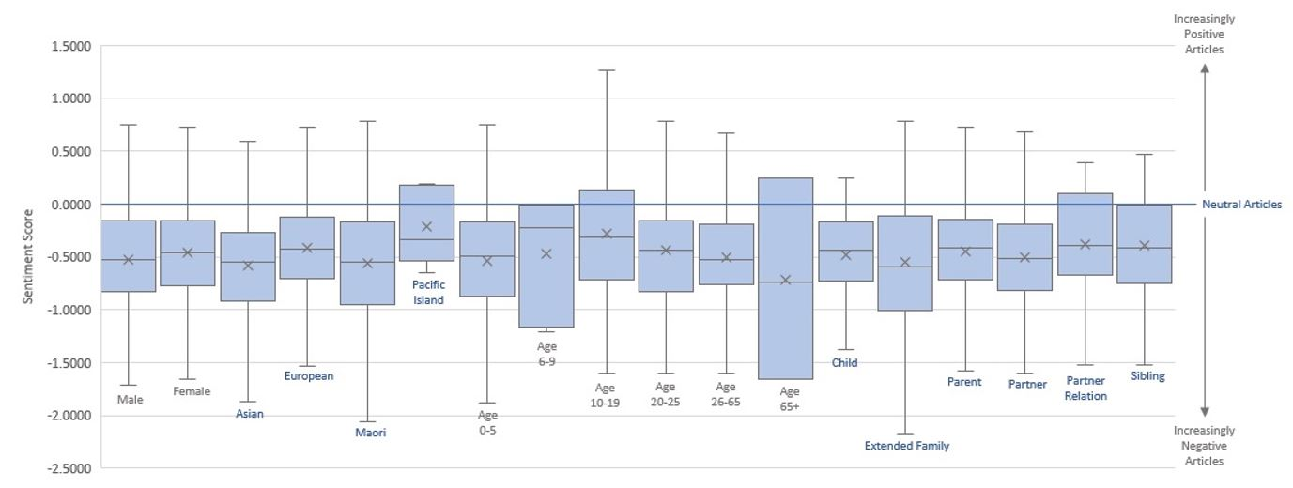
ETHEL Sentiment Scores
Contact: +64 (0)27 332 2998 3963 | Harini@dotlovesdata.com
Notes:
Sentiment Score Data:
‘Sentiment analysis’ is a natural language processing technique that quantifies the emotional polarity of text. This technique has spawned a burgeoning field of research in recent years with applications ranging from analysing the wide-spread mood of the population, to quantifying customer satisfaction, to predicting voter behaviour. Using a proprietary sentiment analyser, we were able to assign a sentiment score to all articles from the cohort written about victims of extreme family violence. By evaluating the sentiment scores of articles relating to victims from different groups, we were able to identify significant differences in the nature of the language used.
With the power to shape community perceptions and improve public visibility of the issues, but also the ability to implicitly condone or even fuel aggression, unbiased equitable media coverage is an essential component in the struggle to eradicate family violence in New Zealand. Our study therefore identifies an opportunity for raising accurate community understanding of extreme family violence in New Zealand and for supporting victims through objective media coverage.

